Slide 1
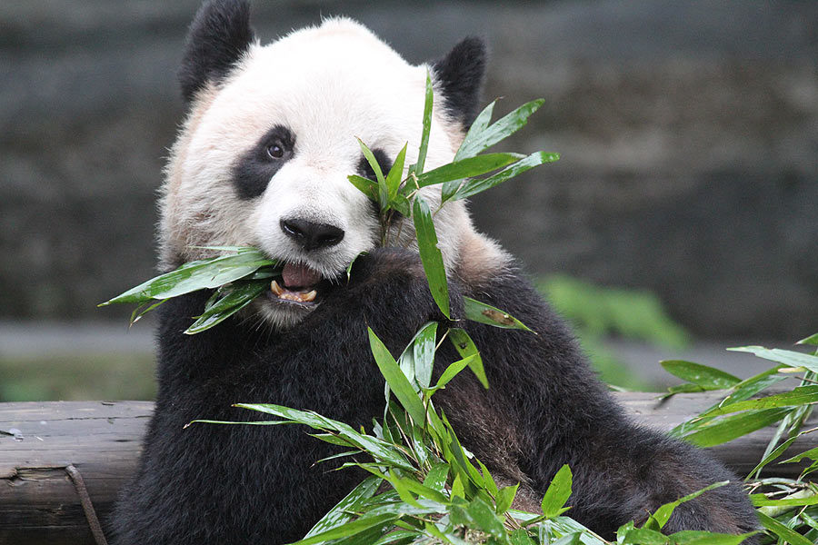
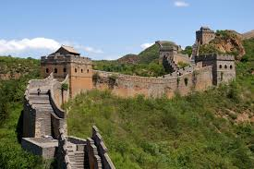
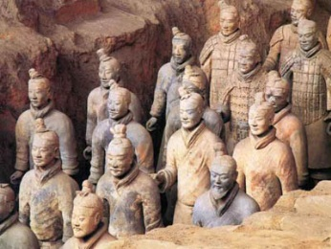
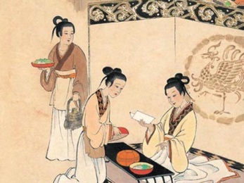
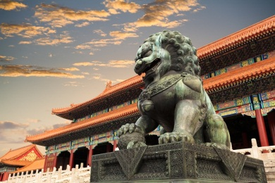
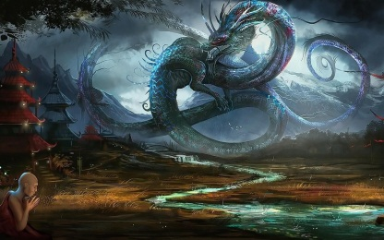
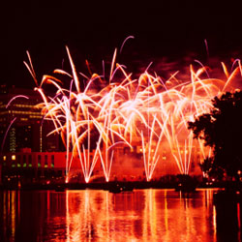
Ancient china
A brief introductory overview

Slide 2
Chinese architecture
Chinese architecture refers to a style of architecture that has taken shape in East Asia over many centuries. The structural principles of Chinese architecture have remained largely unchanged, the main changes being only the decorative details.
The architecture of China is as old as Chinese civilization. From every source of information—literary, graphic, exemplary—there is strong evidence testifying to the fact that the Chinese have always enjoyed an indigenous system of construction that has retained its principal characteristics from prehistoric times to the present day.

Slide 3
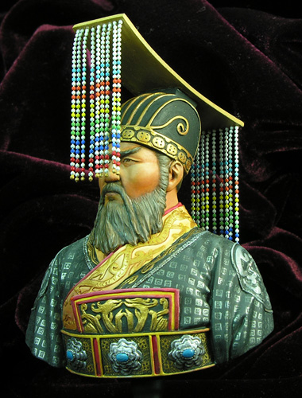
Qin Shihuangd
In order to show his importance and power, Qin added a new name to his own. He began calling himself Qin Shihuangdi, which means Qin, the first emperor of China.

Slide 4
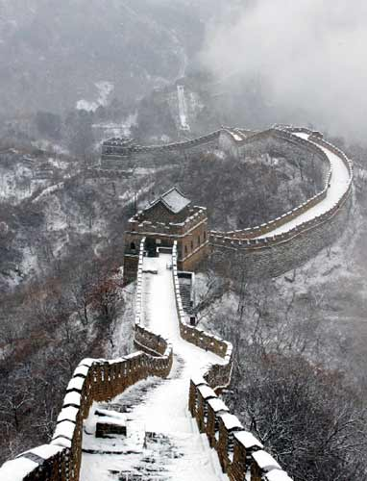
Qin Building Projects
To make China the most glorious nation on Earth, Qin needed labour. He used the peasants, forcing them to work under slave conditions, so that he could build roads, bridges, canals, buildings, and his most famous building project of all, the Great Wall of China.

Slide 5
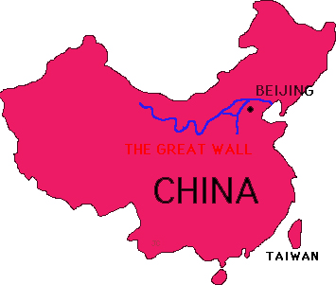
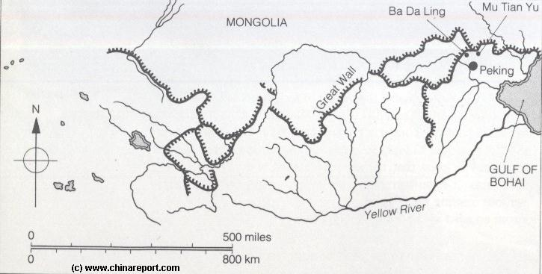
The Great Wall of China
Early emperors had built walls in the northern territories to protect their nation against attack from outside forces. These walls were spread across the landscape, and not connected. Qin ordered his people to connect the existing walls together, and to expand them, eventually covering a distance of over 4000 miles.
THE GREAT WALL

Slide 6
Great Wall of China
Best known example of architecture in China.
The Great Wall of China is a series of fortifications made of stone, brick, tamped earth, wood, and other materials, generally built along an east-to-west line across the historical northern borders of China in part to protect the Chinese Empire or its prototypical states against intrusions by various nomadic groups or military incursions by various warlike peoples or forces.

Slide 7
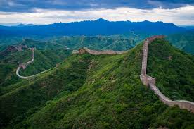
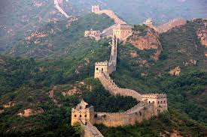
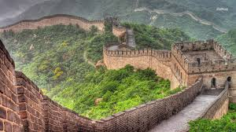
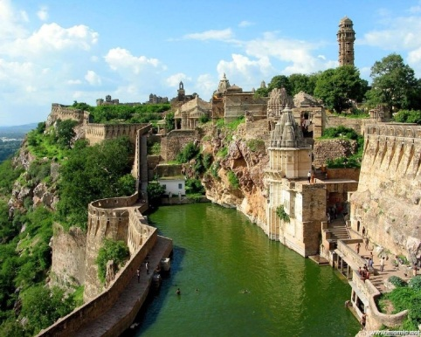
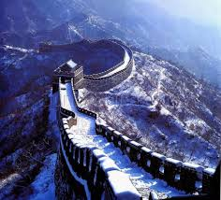
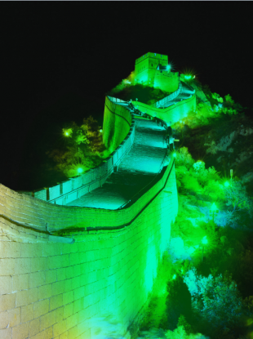
Great wall of china

Slide 8
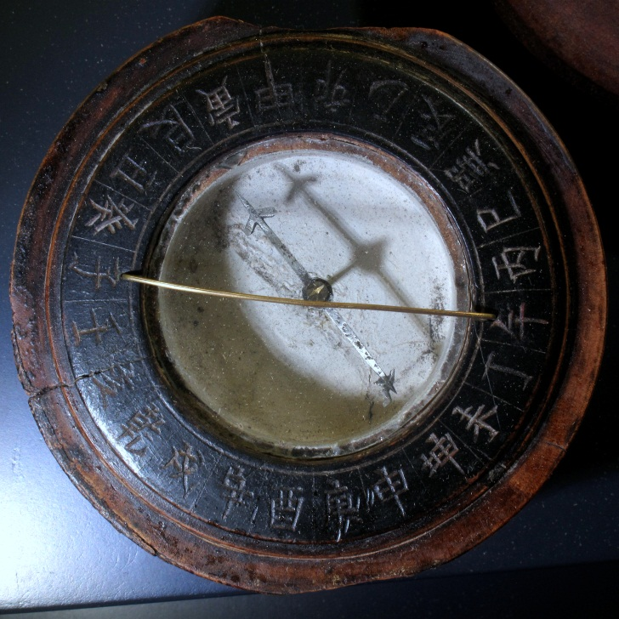
inventions
China has been the source of many inventions, including the Four Great Inventions: papermaking, the compass, gunpowder and printing (both woodblock and movable type).

Slide 9
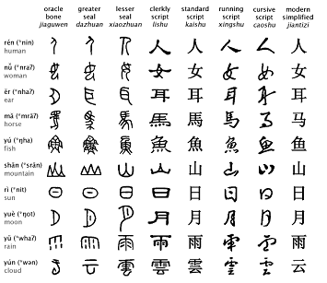
Invention of Writing
One of the most important contributions made during the period that the Shang Dynasty ruled China was the invention of writing. The earliest written records found in China come from this time period.

Slide 10
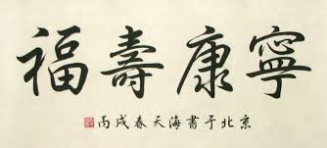
Chinese Writing
Chinese calligraphy is a form of calligraphy widely practiced in China and revered in the Chinese cultural sphere, which often includes Japan, Taiwan, Korea and Vietnam. The calligraphic tradition of East Asia originated and developed from China.

Slide 11
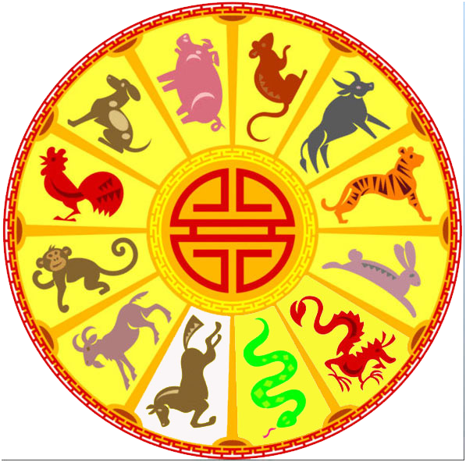
Chinese Calendar
Traditional Chinese calendar is based on the phases o the moon and is lunar.

Slide 12
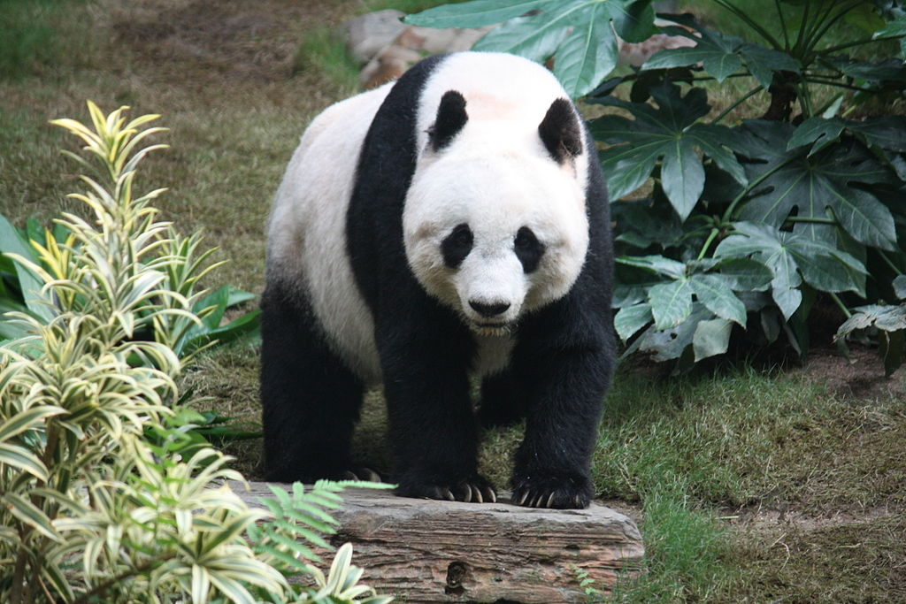
The panda (Ailuropoda melanoleuca, lit. "black and white cat-foot"; simplified Chinese: 大熊猫; traditional Chinese: 大熊貓; pinyin: dàxióngmāo, lit. "big(大 dà) bear(熊 xióng) cat(猫 māo)"),^{[2]} also known as panda bear or the giant panda to distinguish it from the unrelated red panda, is a bear[ native to south central China.

Slide 13
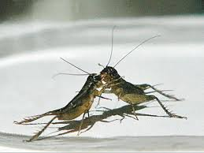
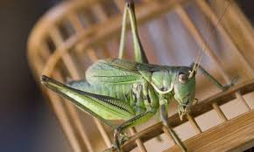
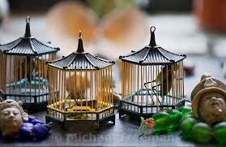
Crickets
Keeping crickets as pets emerged in China in early antiquity. Initially, crickets were kept for their "songs" (stridulation). In the early 12th century the Chinese people began holding cricket fights. Throughout the Imperial era the Chinese also kept pet cicadas and grasshoppers, but crickets were the favorites in the Forbidden City and with the commoners alike.

Slide 14
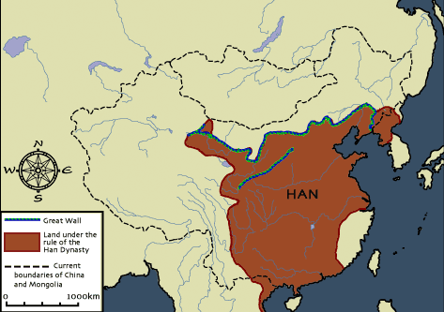
Isolated from Rest of the World
Because of its location amidst high mountains and surrounded on many sides by water, China was isolated from much of the rest of the world. As their civilization flourished and their wealth increased, they were largely unaware of what advancements were taking place in the nations around them.

